Slide 2
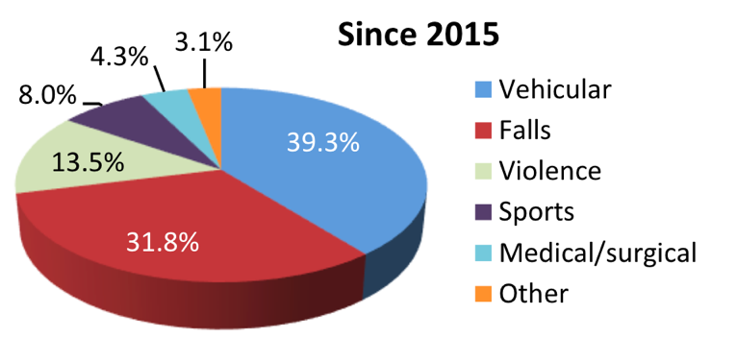
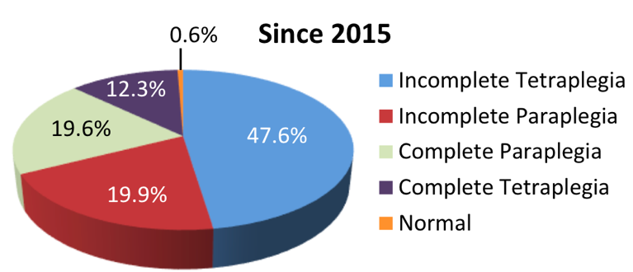
Spinal cord Injury (SCI) Overview
Incidence
Since 2015, in the U.S, about 18,000 new cases each year
Prevalence
Between 250,000 and 368,000 persons
Causes | Neurological Level and Extent of Lesion

Slide 3
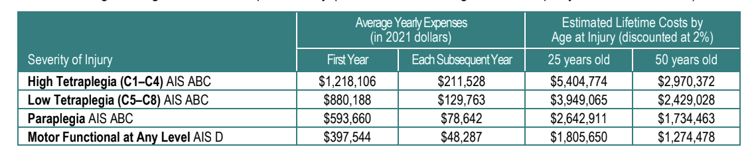
SCI Burden and Critical Needs
Cost*
$2,601 daily average cost for patients with AIS-A,-B, or –C
75% of patients are unemployed 10 years post injury
Lifetime cost: from 1 to 5 Million
Re-Hospitalization*
Since 2015, about 30% of persons with SCI are re-hospitalized one or more times following injury
Leading causes: disease of the skin, respiratory, digestive, circulatory, and musculoskeletal diseases
*National SCI statistical Center, 2019 Data Sheet.

Slide 4
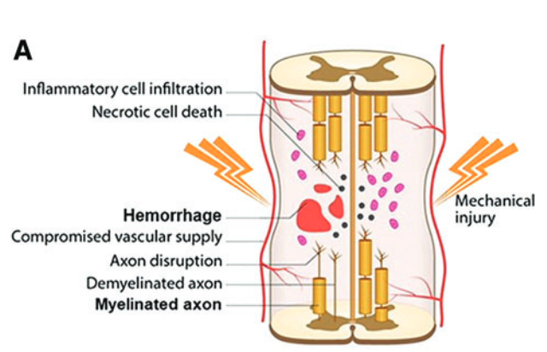
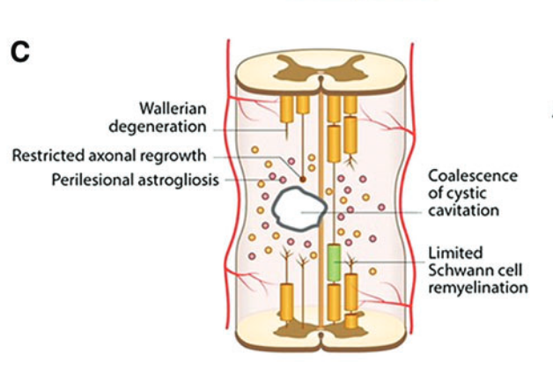
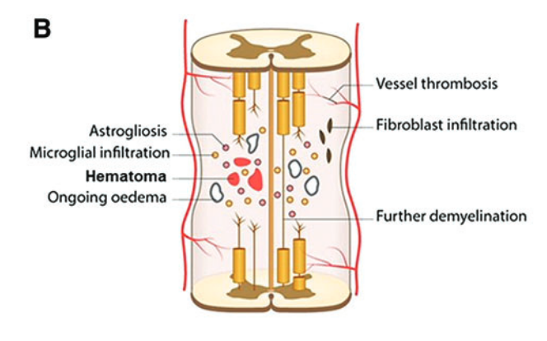
The Pathology of Human Spinal Cord Injury*
Acute Stage
Sub-acute Phase
Chronic Phase
Hours to 1 to 2 days
Days to weeks
Weeks to Months
*Norenberg, Michael D., et al. “The Pathology of Human Spinal Cord Injury: Defining the Problems.”

Slide 5
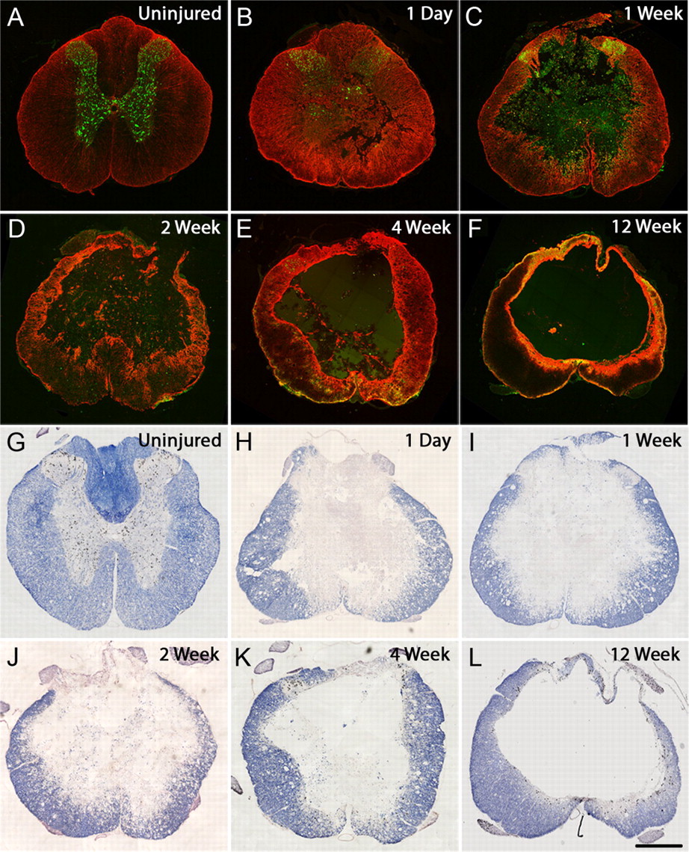
Anatomical Changes from Acute to Chronic Stages*
Compared to uninjured spinal cord, following injury
Progressive cell loss
Reactive gliosis, and cavitation
Decrease of white and gray matter
*Nicholas D. James et al. “Conduction Failure following Spinal Cord Injury: Functional and Anatomical Changes from Acute to Chronic Stages”
Notes:
A 150 kdyn contusion leads to progressive cell loss, reactive gliosis, and cavitation. GFAP and NeuN immunohistochemistry (A–F) and eriochrome cyanine staining (G–L) in transverse sections of the spinal cord through epicenter of the injury demonstrate the pathological changes taking place from acute to chronic time points after injury (1 d to 12 weeks) and can be compared with uninjured spinal cord (A, G). GFAP (astrocytes; red) and NeuN (neuronal cell bodies; green) costaining illustrates the progressive destruction of the gray matter and neuronal cell loss that occurs following injury as well as the pronounced increase in reactive gliosis acutely following injury (B), which at later stages becomes more localized to the borders of the cavity, forming a dense glial scar (C–F). Staining with eriochrome cyanine (to demarcate gray and white matter areas) highlights the initial phase of mass necrosis in the spinal parenchyma at early stages (H–J) followed by clearance of the debris, resulting in large central cavities surrounded by a spared rim of white matter at chronic postinjury time points (K, L). Scale bar, 500 μm.

Slide 6
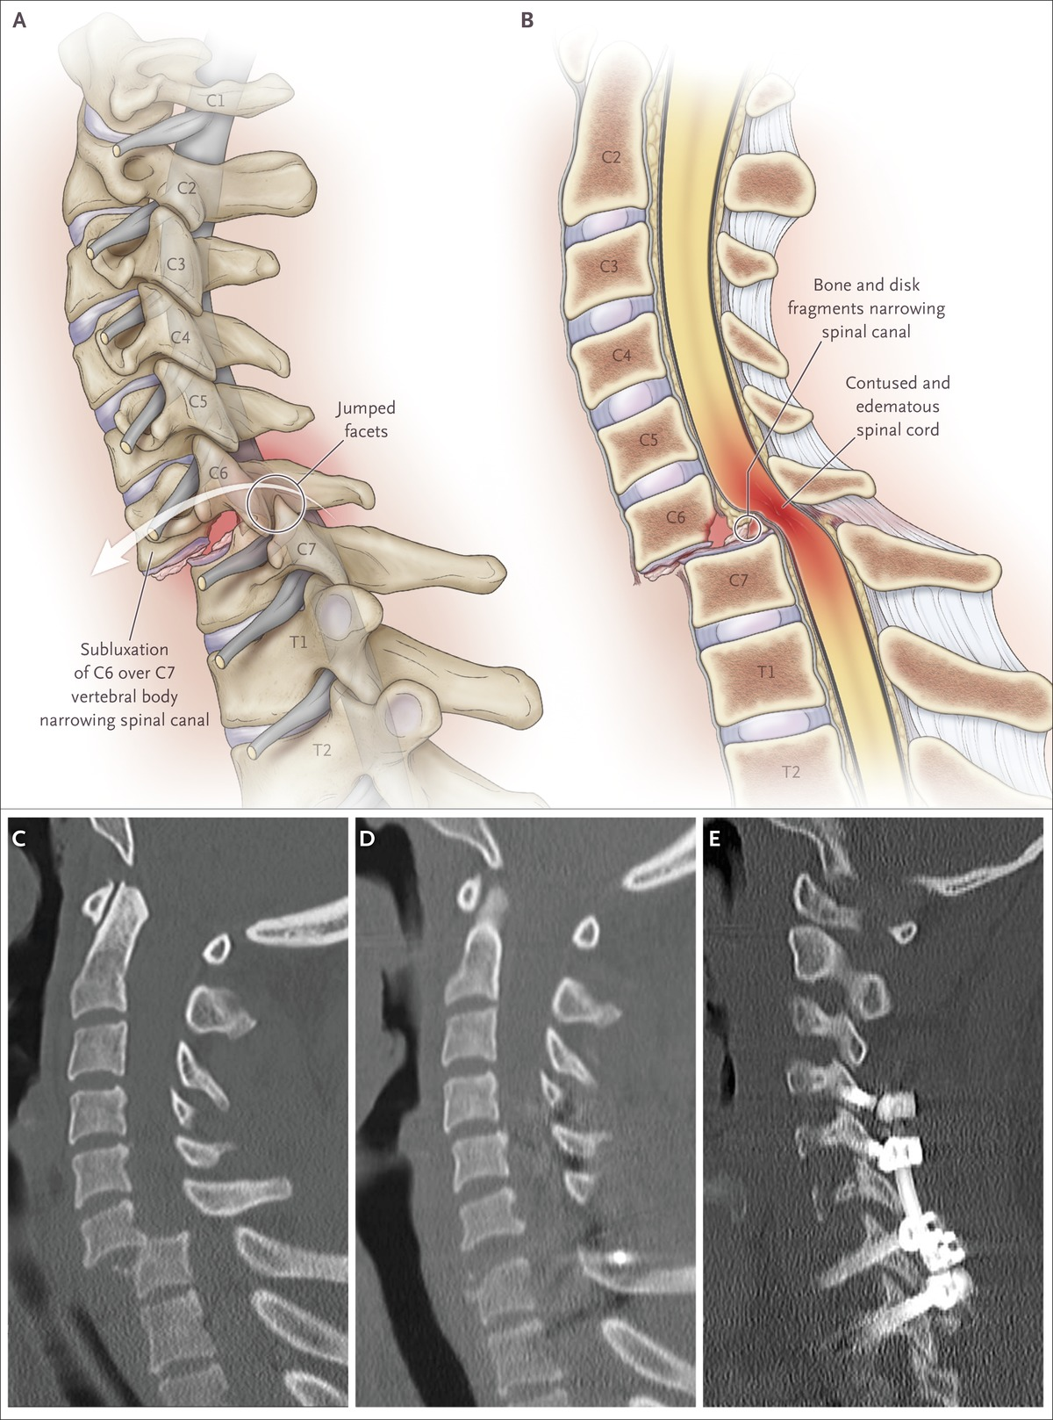
Recovery of Neural Functions in SCI is rare
No globally accepted standard treatment
Traditional treatment consist in:
Stabilization of the vertebral column
Methods to reduce inflammation:
hypothermia, cerebrospinal fluid drainage, anti-inflammatory drugs, electrical field stimulation
- Physical rehabilitation
Goals of modern regenerative therapies
- Minimally invasive
- Targeting the secondary or chronic stages of injury
- Gains in motor function to increase independence and quality of life

Slide 7
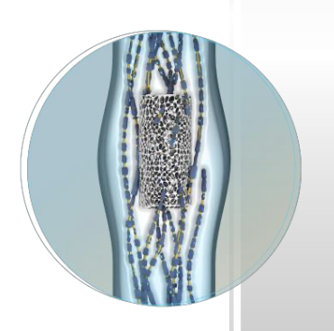
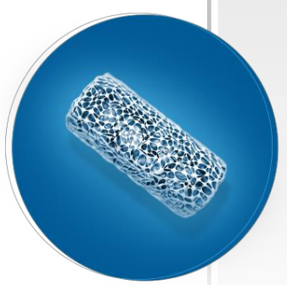
Neural-Spinal Scaffold
PLGA-PLL biopolymer
Biocompatible and bioresorbable
Consists in inner and outer ”mini” tubes
PLGA is the biodegradable scaffold along which cells can grow
- Poly-L-Lysine promotes cellular adhesion
Scaffold is implanted lengthwise at the injury site using a timed internal decompression procedure

Slide 8
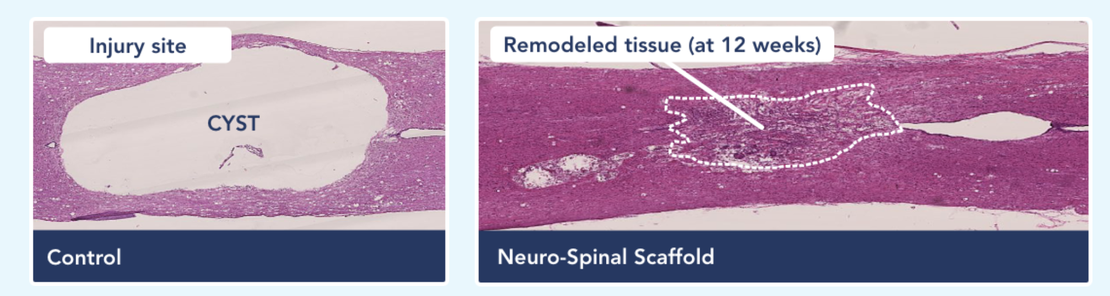
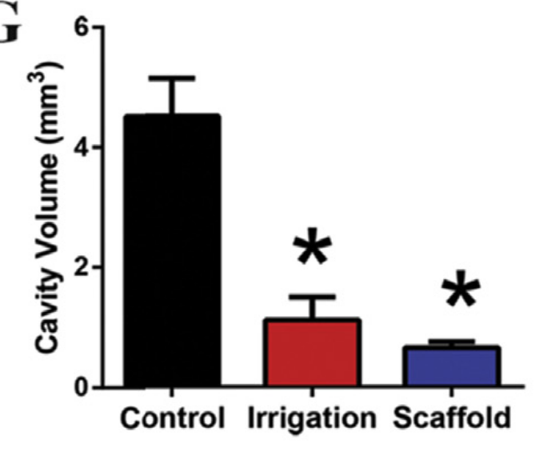
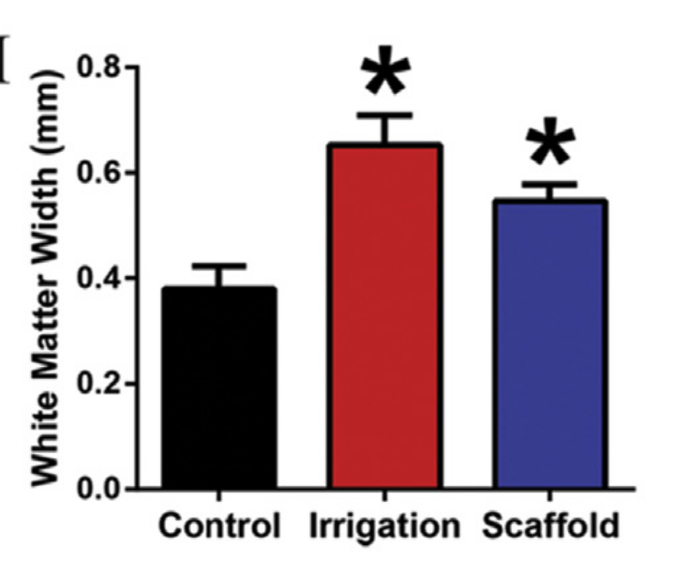
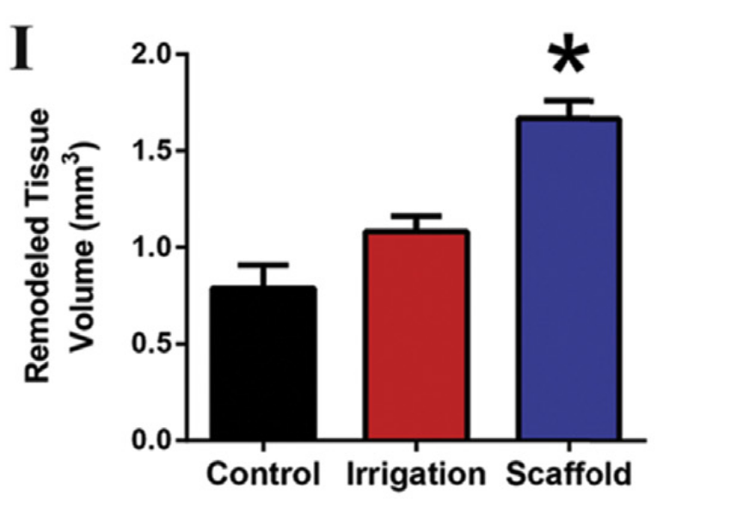
NS Scaffold reduced cystic cavitation and promoted new tissue formation
Rat model of acute SCI (at 12 weeks):
86% in cavity volume
44% preserved tissue
111% increase in new tissue volume
Cyst Reduction
White Matter Sparing
Remodeled Tissue
*p < 0.05

Slide 9
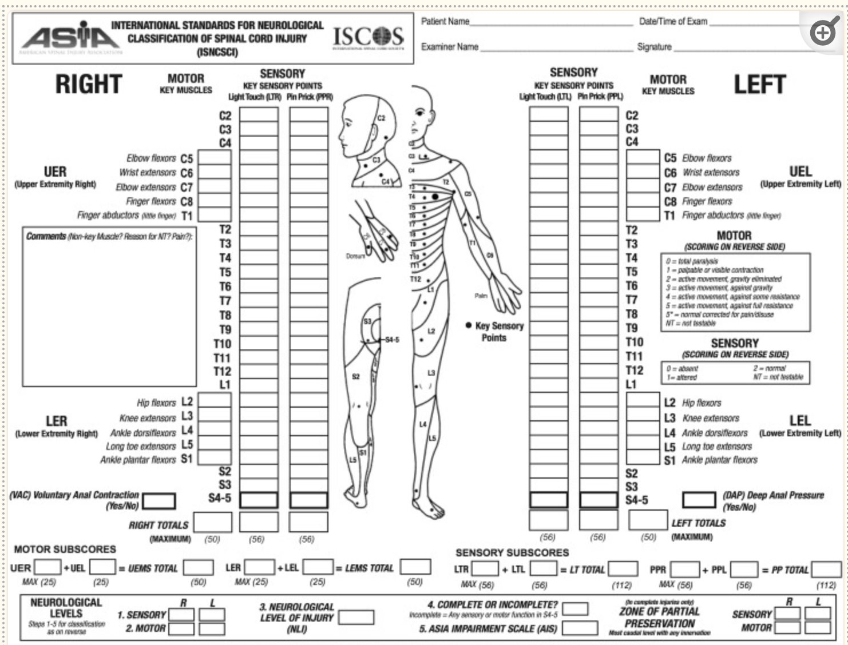
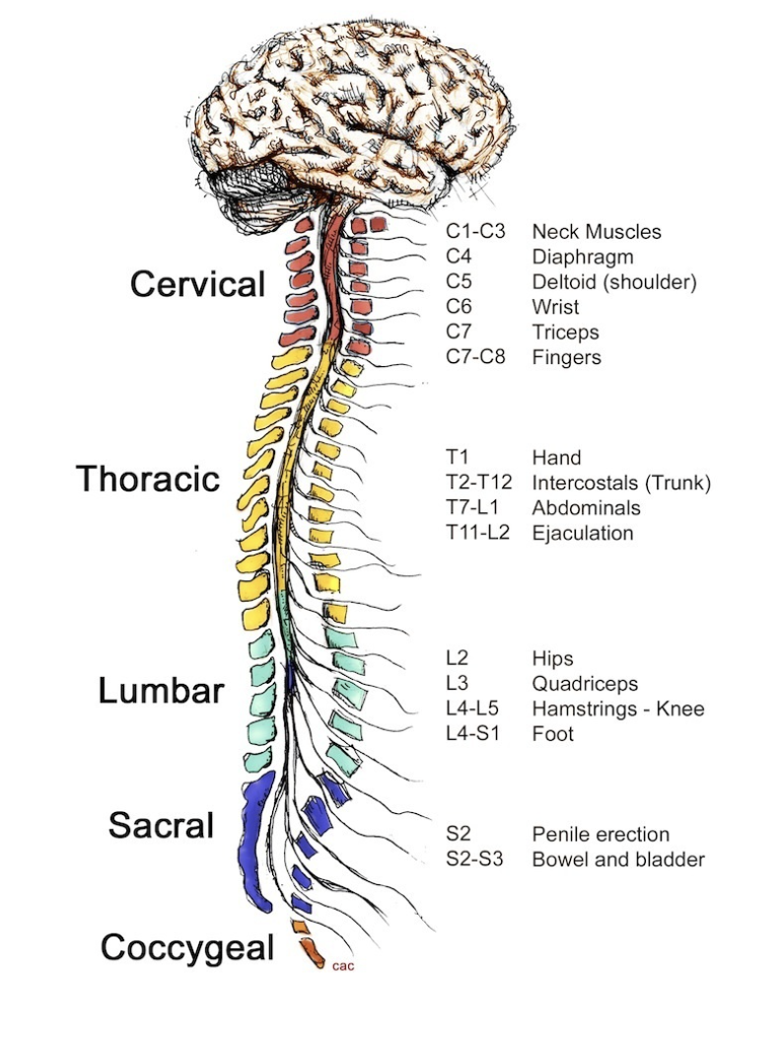
ASIA* Impairment Scale (AIS) Score
*American Spinal Injury Association International Standards for Neurological Classification of Spinal Cord Injury

Slide 10
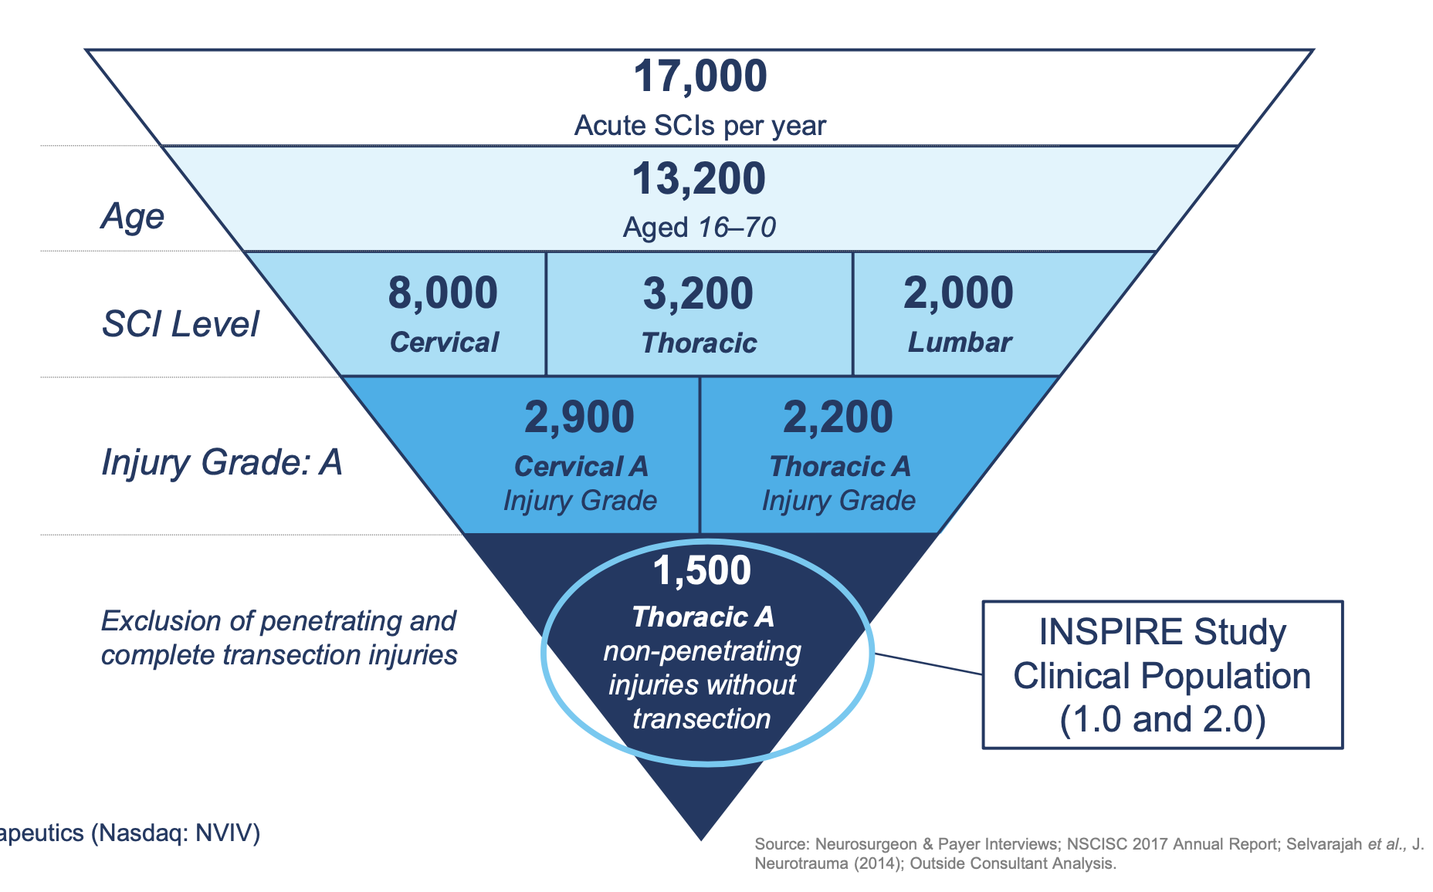
INSPIRE Clinical Trial Cohort Characteristics
Source: Kim, Kee D., et al. “Acute Implantation of a Bioresorbable Polymer Scaffold in Patients With Complete Thoracic Spinal Cord Injury: 24-Month Follow-up From the INSPIRE Study.”

Slide 11
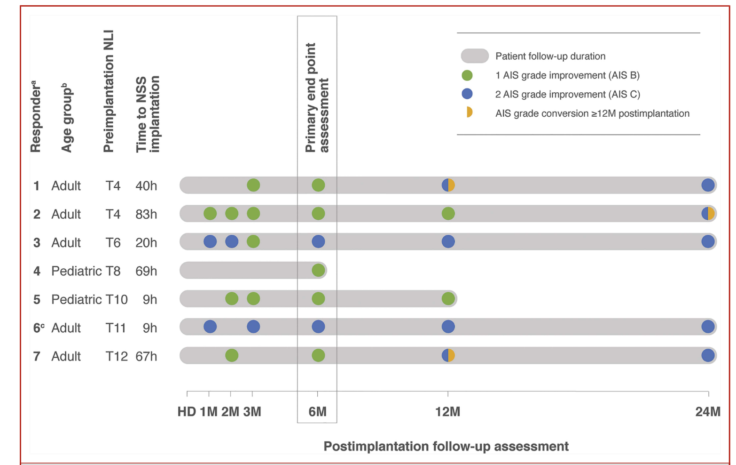
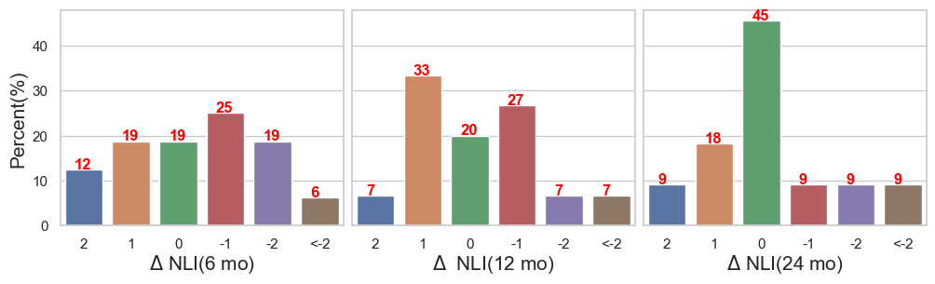
INSPIRE Clinical Trial Results
Out of 16, 7 (44%) patient AIS scores improved
At 6, 12 months, most patients
had NLI score changes
within 2 levels in either direction
At 24 months on majority patients
move back to no improvements

